Slide 1
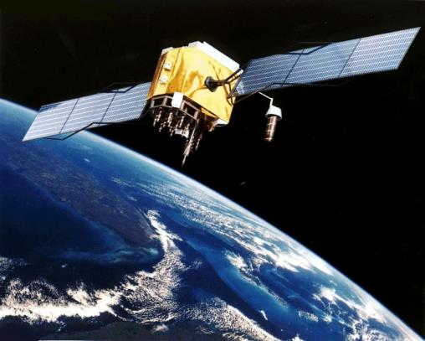
Project Exosphere
Lighthouse customer list

Slide 2















A Few Skyhigh EMEA Customers

